Slide 1
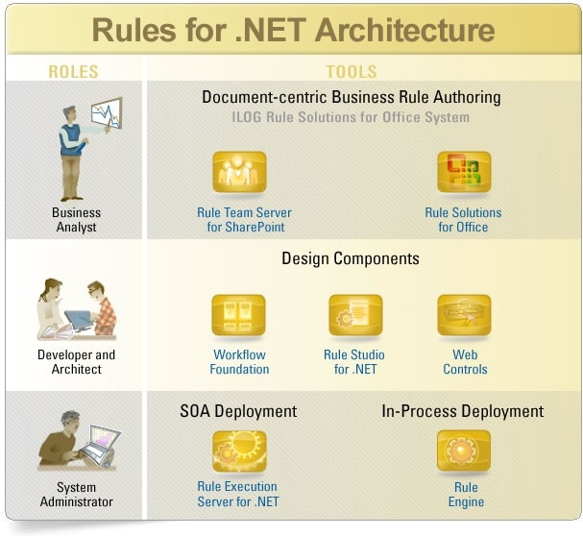
By Anil Kumar

Slide 2
What is Microsoft .NET?
Overview
What is .NET?
  New Microsoft Framework for the Internet Development Environment.
  It is a protocol stack and computing model for TCPI/IP-based, distributed computing.
  The .NET Enterprise servers are built for interoperability from the ground up, using open Web standards such as XML with increased scalability and reliability.
Primary .NET Components
  .NET Architecture
  .NET Integrated Programming
  Common Language Runtime (CLR)
  .NET System Class Libraries
  Data and XML
  Web Services/ ASP+
By Anil Kumar

Slide 3
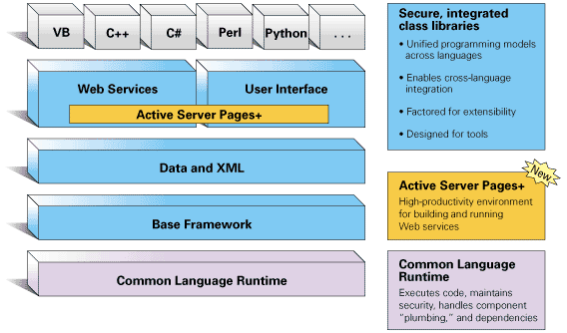
.NET Architecture Overview
By Anil Kumar

Slide 4
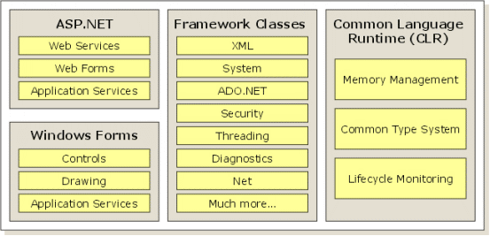
.NET Architecture Overview
.NET Framework Elements
  A runtime engine, called the "Common Language Runtime" (CLR) that handles memory allocation, error trapping, and security features.
  A set of extensive Framework class libraries, written from the ground up that comprise practically any functionality you could ask for.
  Two top-level development "arenas" for web applications (ASP.NET) and regular Windows applications (Windows Forms).
By Anil Kumar

Slide 5
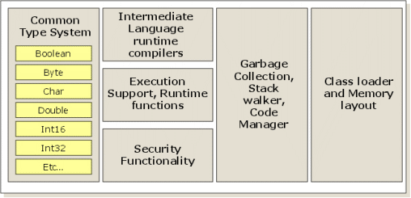
Common Language Runtime (CLR)
CLR Architecture
  .NET applications are compiled to a common language known as Microsoft Intermediate Language, or "IL".
  The CLR, then, handles compiling the IL to machine language, at which point the program is executed.
  The CLR architecture provides expansive tool support , simpler deployment (end of "DLL Hell"), superior scalability, support for multiple programming languages and a common data type system

Slide 6
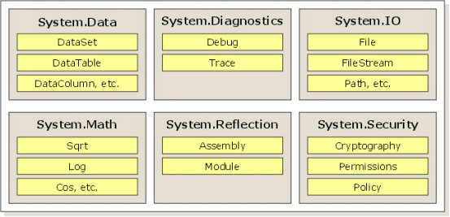
.NET Framework Classes
System Class Library
  Framework classes include user interfaces (Windows Forms (conventional Win32 apps); Web Forms (the forms engine for ASP.NET);
  Server Controls (reusable user interface components dwelling server-side);
  Console Applications; as well as program interfaces—Web services which third-party applications available over the Internet.

Slide 7
Data and XML
ADO+ Architecture
  ActiveX Data Objects+ class library (ADO+) is designed to provide data access services for scalable Web-based applications and services.
  The .NET Data and XML Framework is an integrated evolution of ADO and MSXML
  Language neutral data access and XML support in DataSet (in-memory data cache providing a relational view of the data)
  ADO+ also provides a validation engine that uses XML Schemas to validate an XmlReader.

Slide 8
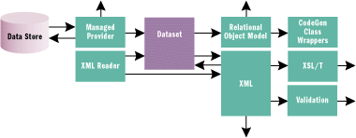
By Anil Kumar

Slide 9
Web Services
A web service is programmable application logic accessible via standard Web protocols
.NET Web Services Toolset
  Built on standard web protocols
  HTTP and XML
  Technology innovations for web services
  SOAP (Simple Object Access Protocol)
    Explicit serialization protocol (HTTP + XML description) used in service exchanges
  SCL (SOAP Contract Language)
    XML document describing the location and interfaces a particular service supports – the client's contract
  DISCO (Discovery)
    XML document that contains references to the SCL location for web services
    Typically lives at the root of a web application
By Anil Kumar

Slide 10
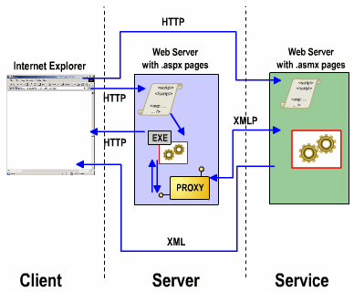
Web Services Model
The Web services execution model involves two entities, the client and the service provider.
In the Web service model, the Web service developer:
Creates the .asmx file that includes the namespace, classes, properties, and methods.
Declares methods as Web methods that can be accessed over the Internet.
Web service model is supported by ASP.NET, a stateless service architecture.

Slide 11
ASP.NET (ASP+)
ASP+ is a simple, consistent, and powerful web application development paradigm for the .NET Framework
  Build web pages (mybank.com)
    Traditionally browser targeted (.aspx)
  Build web services (credit card authorization)
    Programmable application logic (.asmx)
    Uses: SOAP, SCL, and DISCO
Source file (text and notepad accessible) is compiled at run-time
.asmx file can either contain application logic or point to .NET assembly/class
  Ability to programmatically determine what is web service accessible and
  Web service itself emits no UI
    Uses HTML forms to allow interaction with web service

Slide 12
Simple Object Access Protocol (SOAP)
SOAP is an XML based object protocol for the exchange of information in a decentralized, distributed environment.
It consists of: an envelope that defines a framework for describing what is in a message and how to process it, a set of encoding rules for expressing instances of application-defined datatypes, and a convention for representing remote procedure calls and responses.
SOAP (Simple Object Access Protocol)
  Serialization format for request/response semantics using XML and HTTP as transport
  Data is sent via POST (or M-POST)
  Extensible XML document (Envelope, Encoding Rules, RPC)
  Supports complex and simple types (structs, datasets, classes)
SOAP Contract Language (SCL)
  Clients need a contract to understand what the service is providing
  COM used IDL (Interface Definition Language)
  Web Services use SCL
  Supported service transports: SOAP, HTTP-GET, HTTP-POST
  Invocation Semantics: How requests are made and how responses are sent
By Anil Kumar

Slide 13
.NET Security Framework
The .NET Security Framework Architecture consists of the following five core elements.
Evidence Based Security
Code Access Security
Verification
Role Based Security
By Anil Kumar

Slide 14
Evidence Based Security
The key elements of .NET Evidence Based Security consists of Policy, Permission and Evidence subsystems.
Policy
  The XML inscribed policy defines what resources code in executing assemblies can access and in preventing the malicious harming of the integrity of data.
Permission
  Permissions describe resources and associated rights, and implement methods for demanding and asserting access.
  Developers can extend permissions definitions to include application-defined resources. Allows developers granular permission requests within assemblies.
Evidence
  At runtime, the CLR determines permission requests by evaluating the assembly’s evidence. (EX: Code origin (URL,site, etc.); Crypto namespaces, Authenticode, etc.)
By Anil Kumar

Slide 15
ASP.NET Security
The .NET Framework provides a security mechanism called Code Access Security.
Code access security allows code to be trusted to varying degrees, depending on where the code originates and on other aspects of the code's identity.
Code Access Security in CLR
  Every application that targets the common language runtime (CLR) must interact with the runtime's security system.
  To enable code to benefit from code access security, application and component developers must use a compiler that generates verifiably type-safe code.
  Security requests are evaluated by the runtime when the code is loaded into memory.
  Code access security allows class libraries to specify the permissions they require in order to be accessed.
By Anil Kumar

Slide 16
Verification Process
During JIT compilation, the CLR verifies all managed code to ensure memory type safety.
Verification
  The verification process prevents the bypass of common application flow and circumvent security checks during code execution process such as accessing a private field or method from outside its class or accessing residual information in the code memory.
  Buffer overflows, referring to memory containing other than defined variables or method entry points, referencing stack locations outside the allocated stack frame and transferring execution to arbitrary locations within a process.
  The verification process eliminates most of common programming mistakes underlying today’s security vulnerabilities in the type-safe, managed environment provided by the .NET Framework.
By Anil Kumar

Slide 17
Role Based Security
The .NET Framework provides a role based security mechanism to enforce business policy in applications.
Role Based Security
  .NET applications can make authorization decisions based on the principal's identity or role membership, or both.
  To provide ease of use and consistency with code access security, .NET Framework role-based security provides PrincipalPermission objects that enable the common language runtime to perform authorization in a way that is similar to code access security checks.
  The PrincipalPermission class represents the identity or role that the principal must match and is compatible with both declarative and imperative security checks. Security requests are evaluated by the runtime when the code is loaded into memory.
By Anil Kumar

Slide 18

By Anil Kumar

